Slide 1
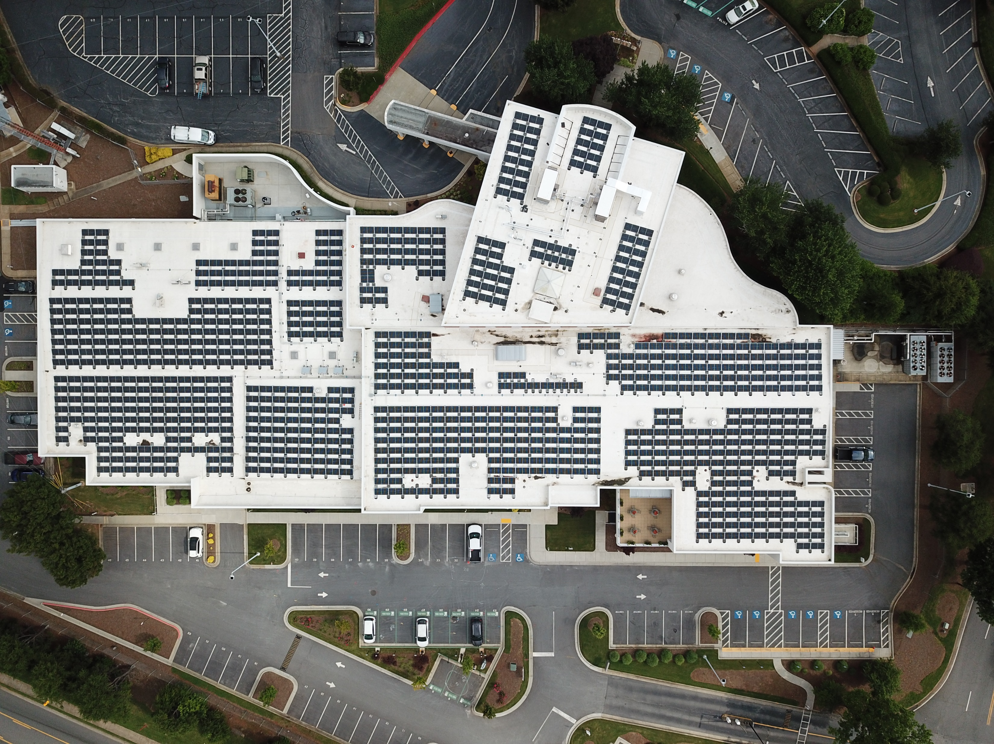
Navigational Channels and Challenges: Utilities and Microgrids
Manish Murudkar
Director, DER Strategy
Manish.Murudkar@cobbemc.com
678-492-5596

Slide 2
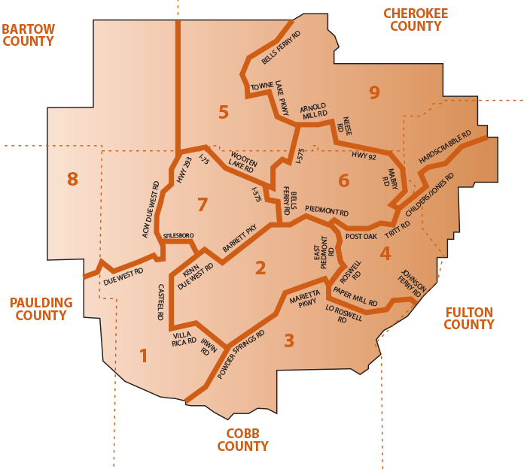
About Cobb EMC
2nd largest EMC in the state of Georgia.
1st largest EMC in the nation in terms of revenue.
100% owner of Gas South LLC., a retail energy marketer.
More than 220K electric meters and about 500K gas customers.
Ranked the 1st most affordable EMC in Georgia, Georgia’s PSC Survey.
Best in class Reliability (According to the EEE Benchmark Study)
Ranked # 1 as the most reliable electric utility in USA (SAIDI)
Ranked # 1 in restoring outages quickly in USA (CAIDI)
Five County Service Territory in NW Suburban Atlanta
9 districts, 9000+ miles of line in 432 sq. miles area
47 substations and 198 feeders

Slide 3
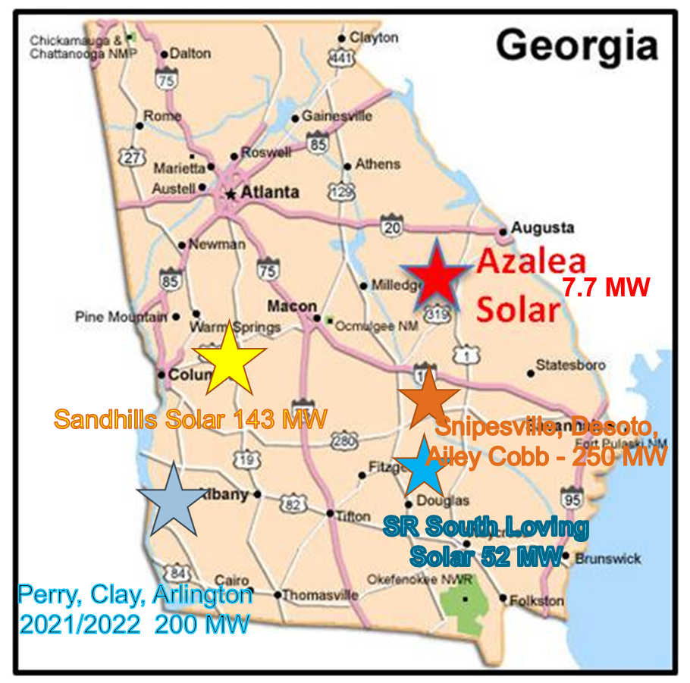
Utility-Scale Solar Projects
Azalea Solar Power Facility
Capacity: 7.7 MW
Location: Washington County, Ga.
COD: 2013
Silicon Ranch South Loving Solar Facility
Capacity (Cobb EMC): 5.04 MW
Location: Jeff Davis County, Ga.
COD: 2016
Sandhills Solar Facility
Capacity (Cobb EMC): 111 MW
Location: Taylor County, Ga.
COD: 2016
Perry, Clay, Arlington
Capacity (Cobb EMC): 25 MW
Location: Houston County, Clay County, Early County Ga.
COD: 2021/2022
Future Solar Facility – Snipesville, Desoto, Ailey
Capacity (Cobb EMC): 50 MW
Location: Jeff Davis, Lee County, Montgomery County Ga.
COD: 2023/2025
2030 Sustainability Goals
Increase renewables by 200%
Reduce carbon emission by 75%

Slide 4
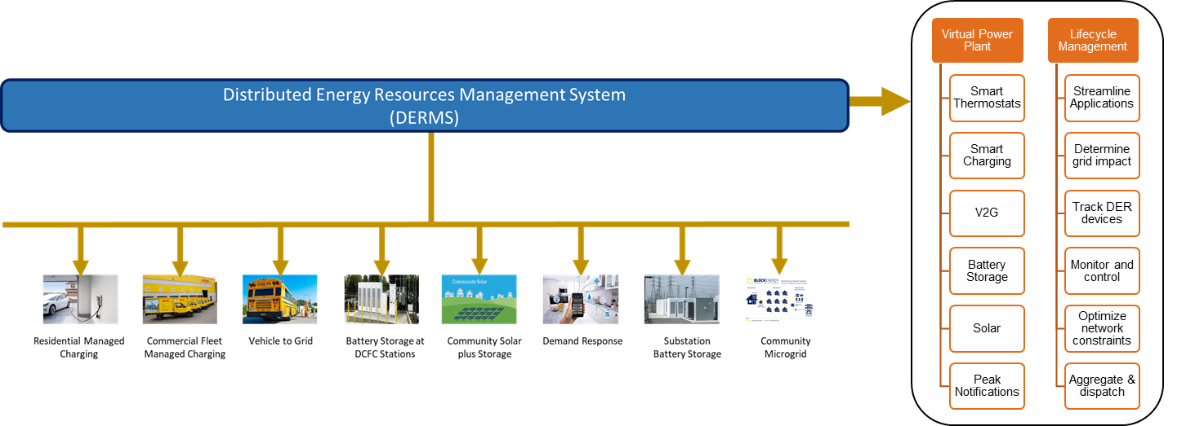
Current and Future DER Initiatives
Current DER Initiatives
Future DER Initiatives
Renewables
Utility-Scale Solar (About 200 MW)
Community Solar (County landfill and DOT Interchange – each 1 MW)
Battery Storage
BTM (Utility-owned – 1 MW/4 MWh)
Energy Efficiency
Energy Network Program
BTM (Utility-owned – 1.5 MW AC)
BTM (Member-owned – about 6 MW)
BTM (Member-owned – 1 out of every 3 install)
Electric Vehicles
NiteFlex Rate Plan
Smart Charging
Microgrid
Campus Microgrid
Substation battery storage (Planned two 5 MW/20 MWh)
Grid Assessment

