Slide 2
Big Plans on Campus: University Microgrids and Research Learnings for the Future
Kristel Watson
Chief Commercial Officer
Scale Microgrids
Dave Good, CEM, LEED-AP BD+C
Director, Energy, Utilities, and Sustainability
Gallaudet University

Slide 3
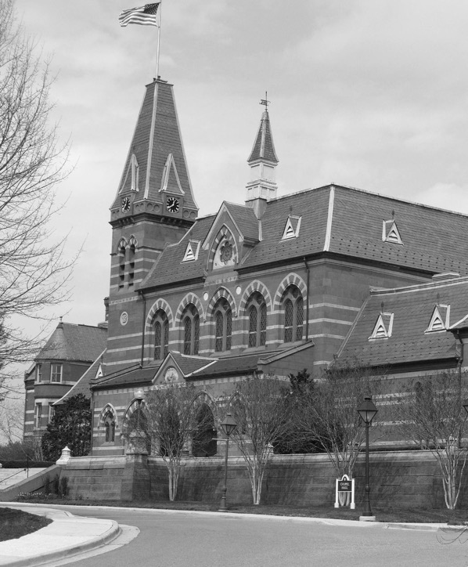
Chartered in 1864, Gallaudet University is a bilingual, diverse, multicultural institution of higher education that supports the intellectual and professional advancement of deaf and hard of hearing individuals through American Sign Language and English.
Gallaudet’s campus encompasses 99 acres in Northeast Washington, DC.

Slide 9
Thank You!
Kristel Watson
Chief Commercial Officer, Scale Microgrids
kwatson@scalemicrogrids.com
Dave Good
Director, Energy, Utilities, and Sustainability
david.good@gallaudet.edu

