Slide 1
A Multi-year >$16M Project to Expand the Microgrid Infrastructure on South Campus

Slide 2
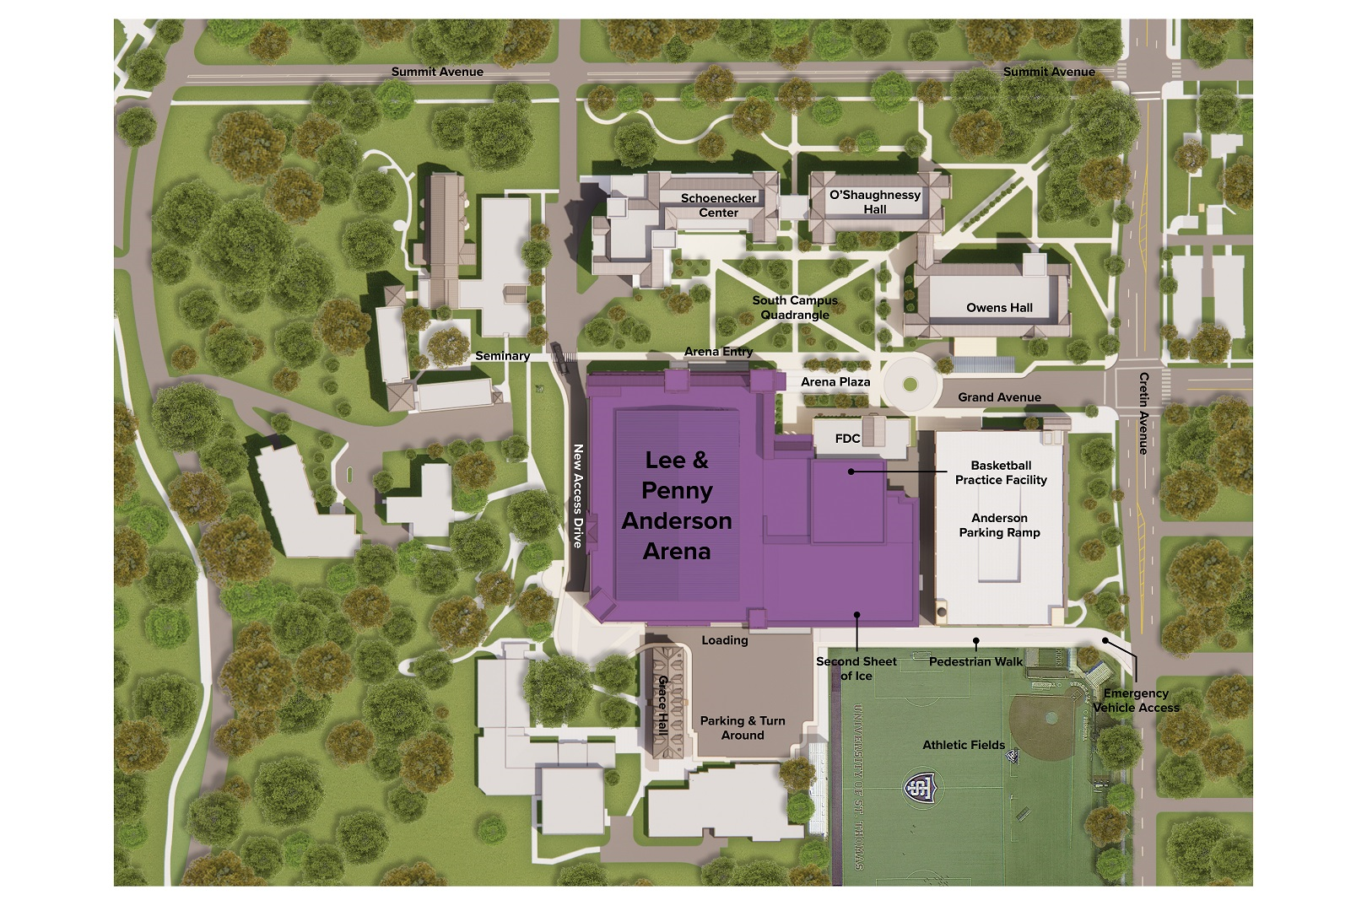
$16M Networked Microgrid Expansion
Microgrid 1:
>2.8MW on-site generation
500kW ESS
350,000 sf of building infrastructure
2 connections points to utility
Connections to other microgrids via 13.8kV loop
Microgrid 2:
>300kW on-site power sources
30,000 sf of building space
600 car parking ramp (EV-chargers)
2 connections points to utility
Connections to other microgrids via 13.8kV loop
Microgrid 3:
>600 kW on-site power sources
New arena:
(2 ice rinks)
~5,000 person
250,000 sf
Dorms
connection point to utility
Connections to other microgrids via 13.8kV loop

