Slide 1
Microgrid Knowledge Conference
April 23, 2024
Willey Sandell

Slide 2
Who is American Municipal Power, Inc. (AMP)?
Ohio public power systems formed AMP-Ohio in 1971 to strengthen wholesale market buying power, gain access to transmission and enhance advocacy efforts; became AMP in 2009
Today, AMP provides wholesale power and services to 132 municipal electric systems in nine states (DE, IN, KY, MD, MI, OH, PA, VA and WV)
Members serve approximately 650,000 meters; nearly 3,500-megawatt peak
Diverse generation portfolio, including hydro, coal, natural gas, solar, wind and diesel
Approximately 200 Employees; $5.7 billion in assets; $1.2 billion in annual revenue
Operate in PJM and MISO
22-member Board of Trustees made up of Member officials meets monthly
Closely aligned with the Ohio Municipal Electric Association (OMEA)
AMP Transmission (AMPT) a wholly owned subsidiary
Notes:
Assets and Revenue as of year ending 12/31/22
The public power leaders who formed AMP in 1971 joined forces to:
Gain economies of scale in power supply
Amplify their bargaining position
Fight for access to areas previously blocked by investor-owned utilities
In its first 25 years, AMP’s focus was:
Joint ownership of electric facilities
Pooled buying power in energy markets, and
Alternative means of generating, transmitting and distributing electric power and energy to benefit customer-owners
A forum for members to come together on mutual aid, safety training, other programs, and regulatory and policy matters
Through the years, AMP has developed a variety of programs and services to meet member needs and help them gain economies of scale by working together on projects.

Slide 3
AMP Mission, Vision and Values
Mission
To serve Members through public power joint action, innovative solutions, robust advocacy and cost-effective management of power supply and energy services
Vision
To be public power’s trusted leader in providing Members and their customers the highest-quality, forward-looking services and solutions
Values
Integrity - Be honest, fair, reliable, trustworthy and ethical
Member Focus - Provide dedicated and professional support to all Members in the AMP footprint
Partnership - Collaborate to achieve common goals
Employee Engagement - Commit to a diverse, inclusive, safe and supportive work environment
Stewardship - Manage resources wisely and sustainably while striving for operational, financial and administrative excellence
Innovation - Energize and inspire new and creative approaches that increase value to Members and Employees
Accountability - Be responsive and communicate transparently and effectively

Slide 4
AMP Members
Notes:
AMP provides wholesale power and services to 132 Municipal members in Indiana, Kentucky, Maryland, Michigan, Ohio, Pennsylvania, Virginia and West Virginia; and the Delaware Municipal Electric Corporation, a joint action agency with eight municipal members in Delaware.

Slide 5
AMP’s BTM Project Overview
Identified the need to hedge the escalating capacity and transmission costs of Member power supply
Evaluated multiple resources to address the need – decided that behind the meter (BTM) resources were best option
Transmission Peak Shaving - Operation of unit during transmission zone’s annual peak hour in PJM and monthly peak hour in MISO
Capacity Peak Shaving - Operation of Unit during PJM’s five highest peak hours and units used to meet member capacity requirements in MISO (LMR – load modifying resource)
Energy Supply - Operation of Unit during high price market hours
Reliability - Backup/emergency power for host community

Slide 6
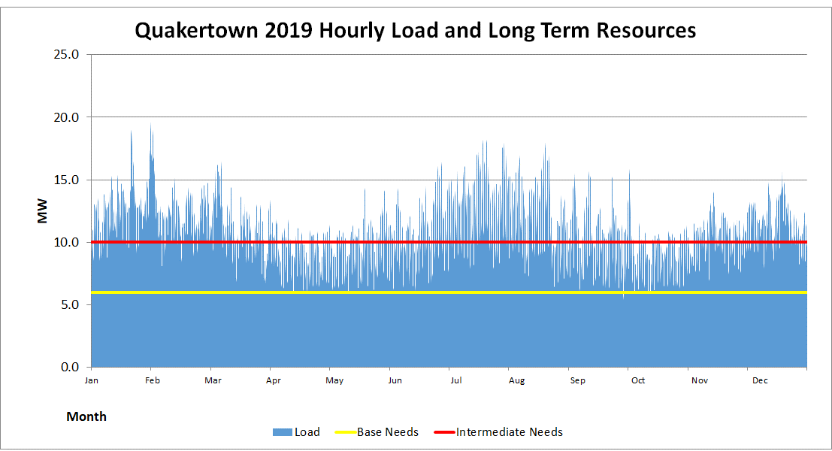
Power Supply
Existing Peaking 0 MW of 10 MW Needs
Existing Int. 0 MW of 4 MW Needs
Existing Base 4 MW of 6 MW Needs

Slide 7
Peak Shaving Example

Slide 8
Things to Consider for BTM Generations (PJM)
Where is the generation being located?
In-front of the meter (participate directly in the wholesale electric markets)
Behind the meter (net against a Member’s load in PJM)
BTM connections
Obligated to inform PJM
Must comply with your Interconnection Agreement (IA) with the local investor owned utility (IOU)
For ATSI (FE) the IA is between FE and AMP on behalf of the Members
For all other IOU, the IA is between them IOU and the Member
AMP can assist
No Electrical Backfeed into the interconnection IOU
MISO- Interconnection is through the local IOU and MISO does not need to be informed
Get involved early in the process

Slide 9
Things to Consider for BTM Generations
Generation considerations
Understand your distribution system, how it is operated and where you plan to inject the generation
What is your fault current; do you have a tie breaker and normal position; distribution line size
Know your load
If using intermittent generation; need to know your load for all seasons
If using peaking generation (e.g. diesel); need to know your peak load
Make sure that the generation is positioned so that it does not cause issues on the distribution system.
Interconnection costs can be expensive
The IOU can request funds to upgrade their system
There will likely be additional interconnection cost to connect to your distribution system per the IA
Reverse Power relay trips; Direct Transfer Trips, etc.
Notes:
Willey- Michelle suggested using the Woodville example for load flow.

Slide 10
Things to Consider for BTM Generations
Working with a 3rd Party Developer
Do a technical review of your draft contracts
Perform credit/financial check on developer
Place onus on developer to comply with all requirements including:
Technical
Safety requirements
Environmental
Permitting requirements
Metering
Once the site is operational:
Will the site be sold to another party?
Who will provide monitoring and maintenance of the facility?
Who is ensuring all guarantees are met?

Slide 11
For more information visit www.amppartners.org

