Slide 1
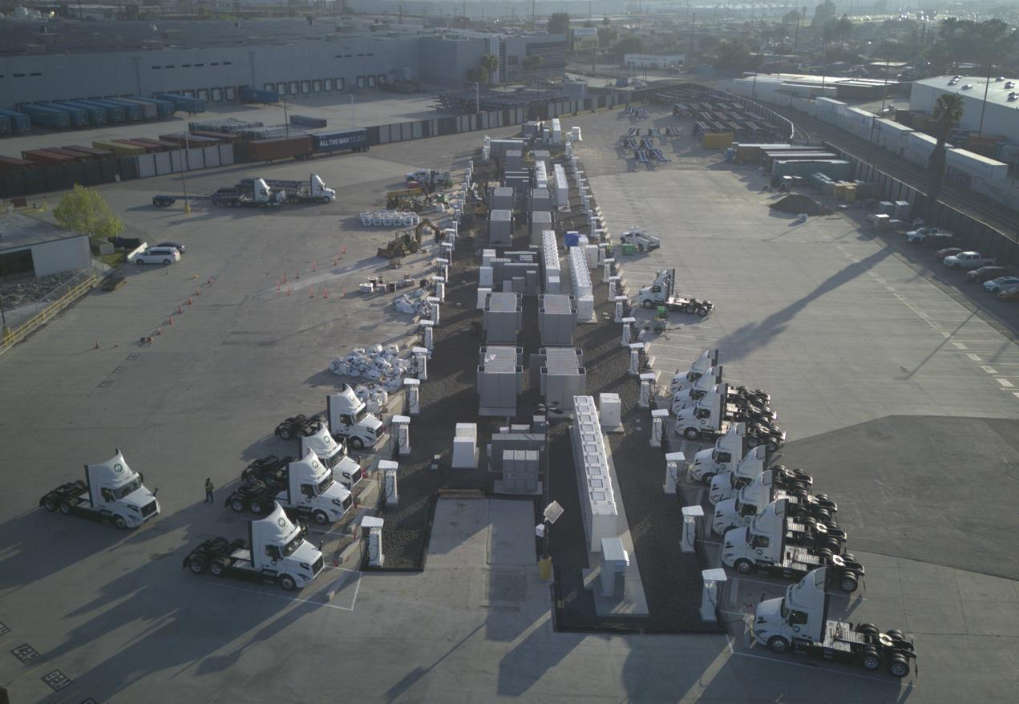
9MW in just 12 months One of World’s Largest Microgrid EV Charging Projects
MOBILITY
96
1.3T/d
Charge points
H²-to-EV ready
6MW 3h
3MW
energy storage
generation capacity
Location: Torrance, California
Key features
Linear generators, BESS, DCFCs
Avoided 3 years of grid delay
Additional reliability when grid joins
Renewable Natural Gas & H² flexible
May 6, 2024

Slide 2
EV Charging Benchmarks CO2 Emissions Comparison
Mobility
CO2 Emissions for Class 8 Trucks (gCO2/mi)

Slide 3
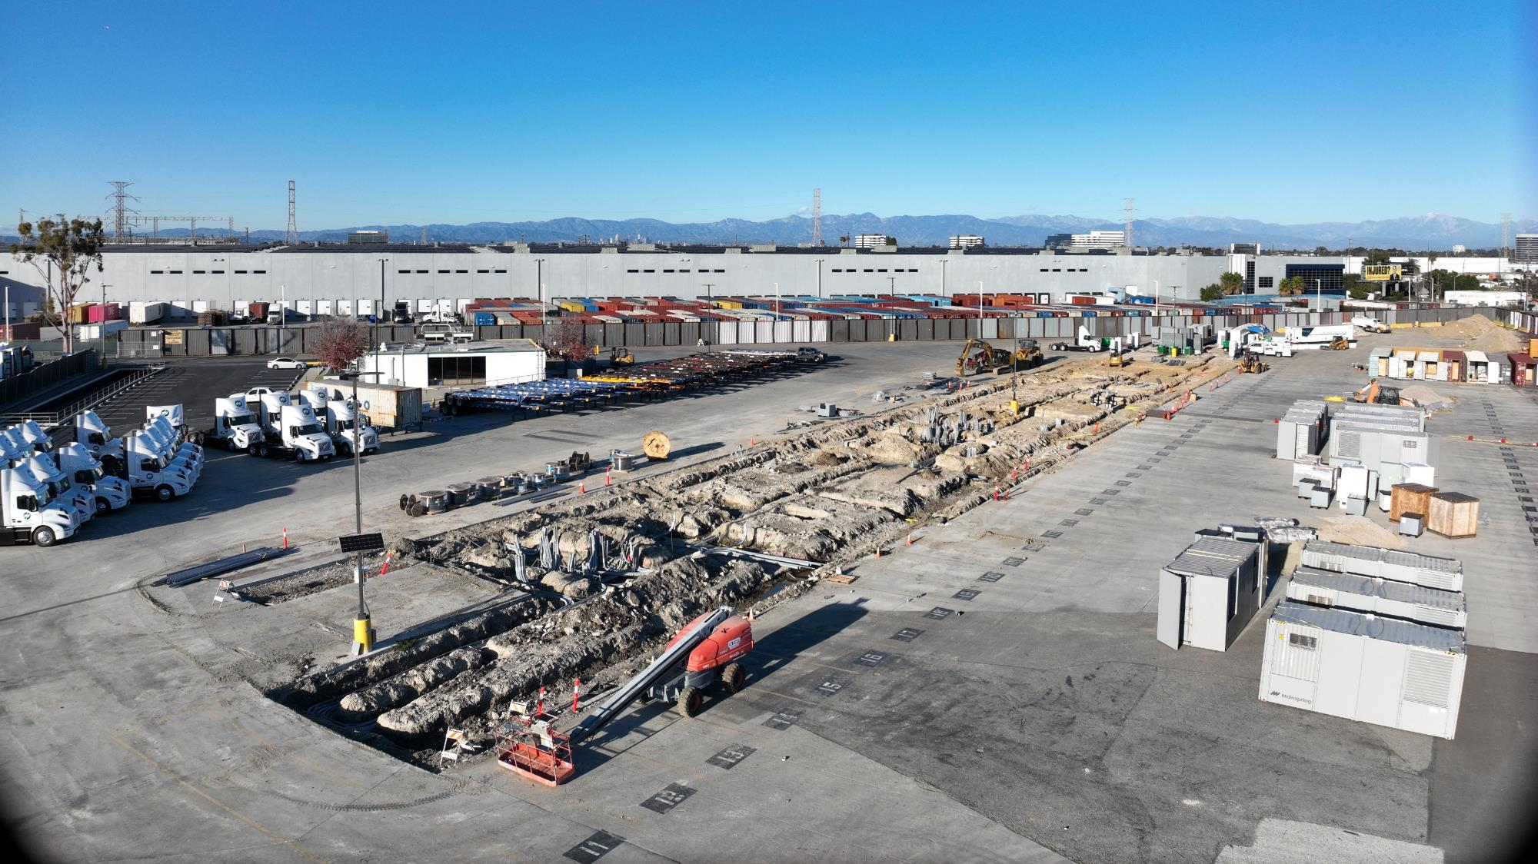

Slide 4
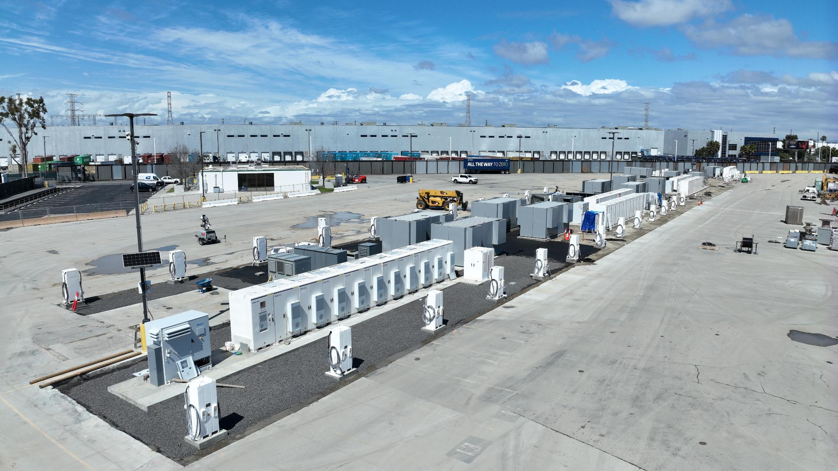

Slide 5
